Slide 1
Linformer & Performer
Gholamreza Dar - Amirhassan Amirmahani

Slide 2
Linformer

Slide 3
Linformer
Linformer: Self-Attention with Linear Complexity
Sinong Wang, Belinda Li, Madian Khabsa, Han Fang, Hao Ma
Facebook AI, USA

Slide 4
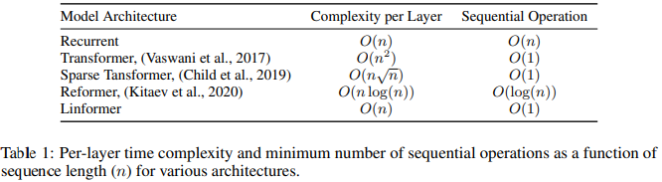
Transformer Complexity : O(n²)
“ the representation of each token is updated by visiting all the other tokens that are present in the previous layer.”
This is essential for retaining long-term information
provides Transformers with the edge over recurrent models on long sequences
Notes:
In the self-attention mechanism, the representation of each token is updated by visiting all the other tokens that are present in the previous layer. This operation is essential for retaining long-term information. It also provides Transformers with the edge over recurrent models on long sequences. However, attending to all the tokens at each layer provokes a complexity of O(n2) with respect to the sequence length.

Slide 5
Why Linformer?
Training and deploying large Transformer models can be COSTLY
The key efficiency bottleneck in standard Transformer models is the model’s self-attention mechanism.
Answering “can Transformer models be optimized to avoid this quadratic operation, or is this operation required to maintain strong performance?”

Slide 6
Prior Work : introducing sparsity into attention layers
by having each token attend to only a subset of tokens in the whole sequence. This reduces the overall complexity of the attention mechanism to O(n√n)
2% drop with only 20% speed up

Slide 7
Prior Work : Reformer
used locally-sensitive hashing (LSH) to reduce the self-attention complexity to O(nlog(n)).
efficiency gains only appear on sequences with length>2048
the Reformer’s multi-round hashing approach actually increases the number of sequential operations, which further undermines their final efficiency gains.

Slide 8
Main idea of the paper
inspired by the key observation that self-attention is low rank.
“attention dot product matrix can always be closely approximated by a matrix of much lower rank.”
Which can be obtained by calculating the singular value decomposition (SVD) of the key and value matrices
https://en.wikipedia.org/wiki/Singular_value_decomposition
Notes:
In this paper, the authors show both theoretically and empirically that the attention dot product matrix can always be closely approximated by a matrix of much lower rank, which can be obtained by calculating the singular value decomposition (SVD) of the key and value matrices and only using a fixed number of the largest singular values.
inspired by the key observation that self-attention is low rank.
we decompose the original scaled dot-product attention into multiple smaller attentions through linear projections, such that the combination of these operations forms a low-rank factorization of the original attention.

Slide 9
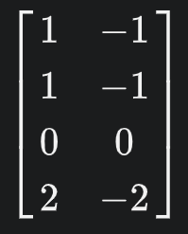
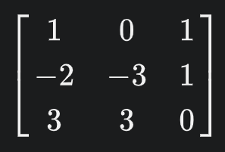
Rank
In linear algebra, the rank of a matrix A is the dimension of the vector space generated (or spanned) by its columns.
-wikipedia
the number of linearly independent rows or columns
Rank : 1
Rank : 2

Slide 10
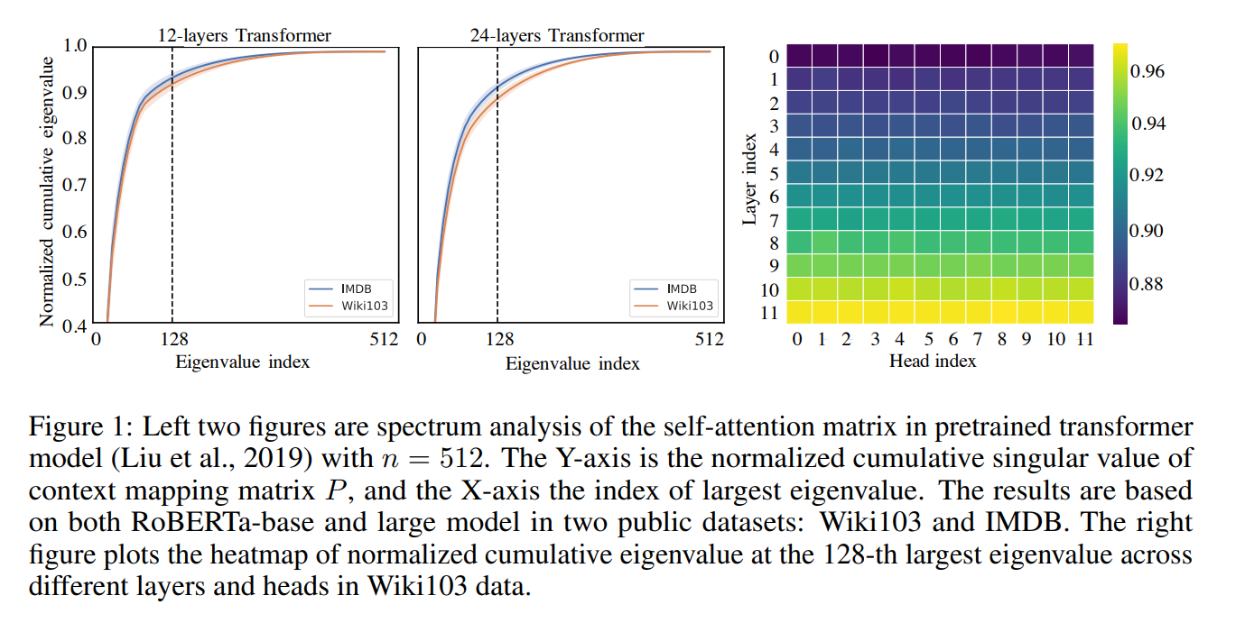
The Observation

Slide 11
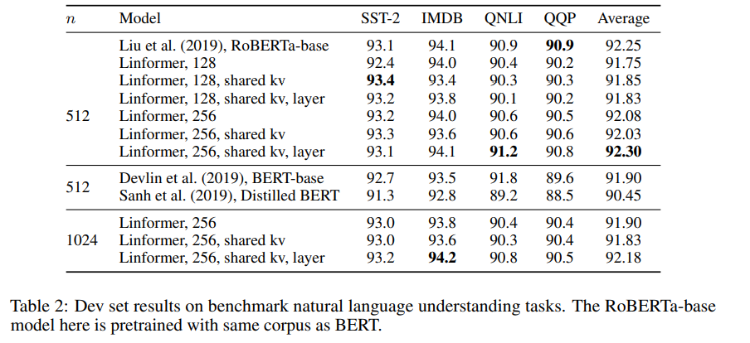
Benchmark results
Linformer is faster but usually less performant (in some cases outperforms transformer)
“the performance of Linformer model is mainly determined by the projected dimension k instead of the ratio n/k. “

Slide 12
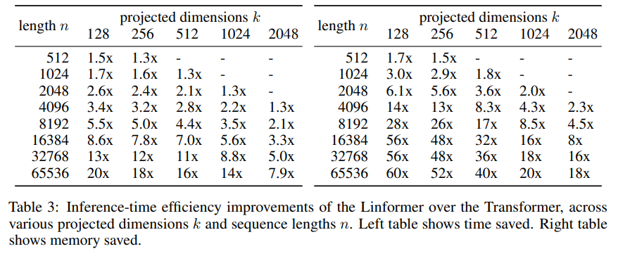
Inference-time Efficiency Results
benchmarking inference speed and memory on a 16GB Tesla V100 GPU card
Left table shows time saved compared to a regular Transformer
Left table shows memory saved compared to a regular Transformer

Slide 13
Broader Impact
Can improve working with images drastically
Can be more environment friendly due to less power consumption
However may have potential ethical problems (with great power comes great responsibility)

Slide 14
Performer

Slide 15
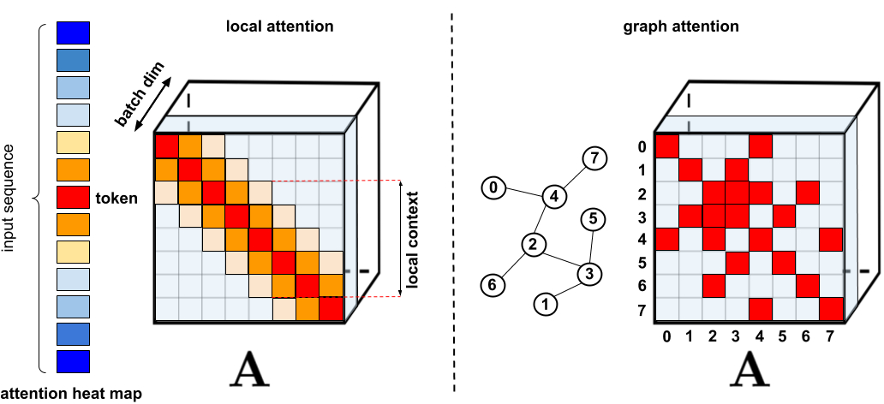
sparse attention

Slide 16
sparse attention limitations
They require efficient sparse-matrix multiplication operations, which are not available on all accelerators
they usually do not provide rigorous theoretical guarantees for their representation power
they are optimized primarily for Transformer models and generative pre-training
they usually stack more attention layers to compensate for sparse representations, making them difficult to use with other pre-trained models, thus requiring retraining and significant energy consumption

Slide 17

sparse attention limitations

Slide 18
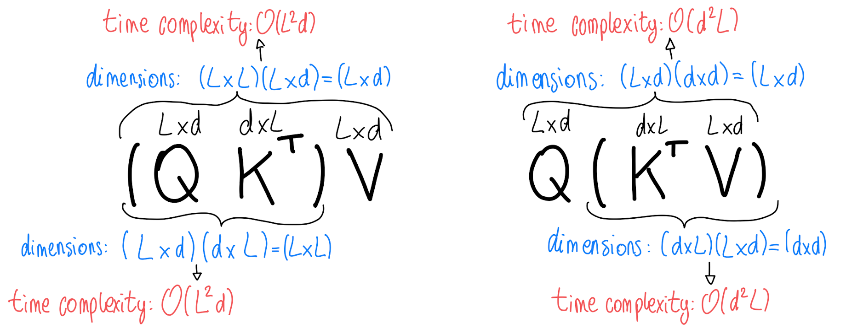
Performer work style

Slide 19
Performer work style

Slide 20


Performer work style

Slide 21
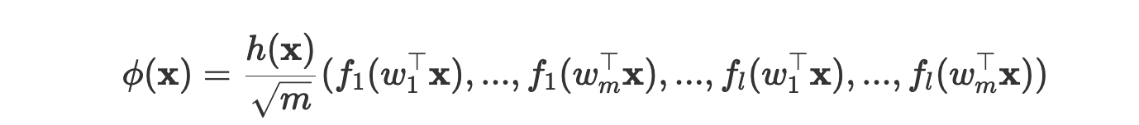


Performer work style

Slide 22
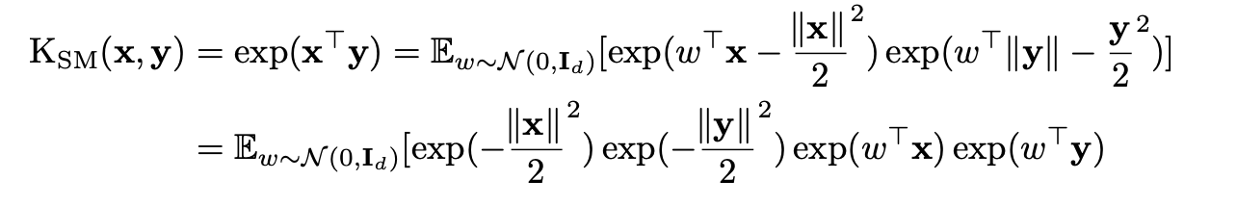

Performer work style

Slide 23
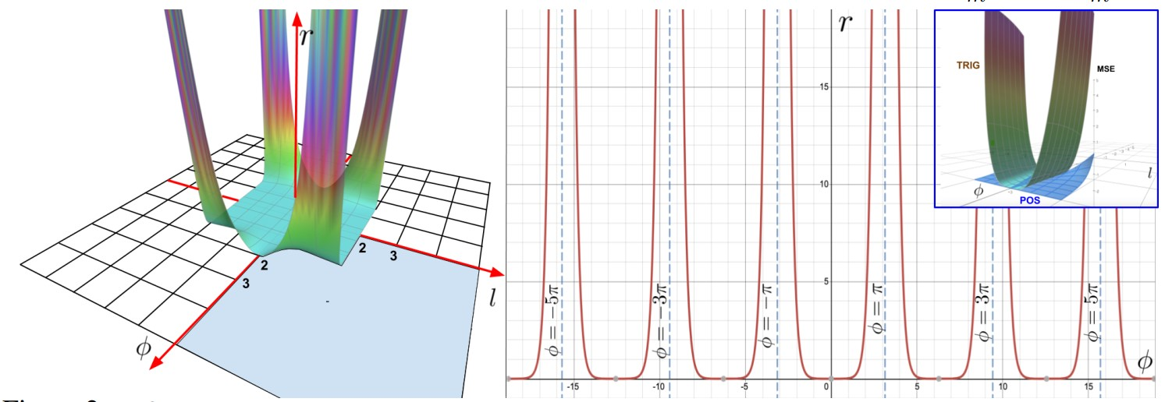
Problem

Slide 24
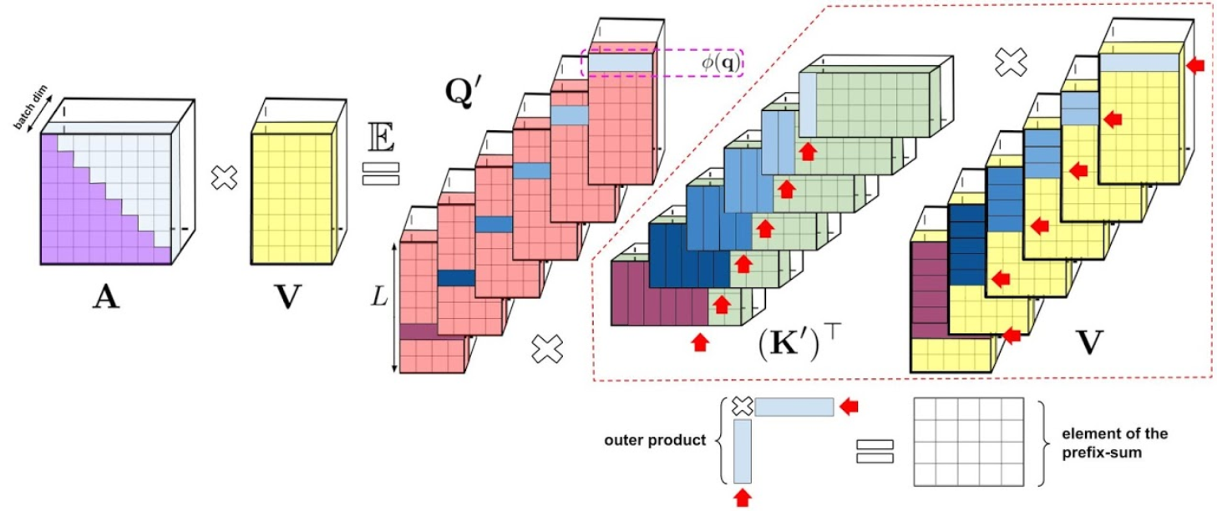
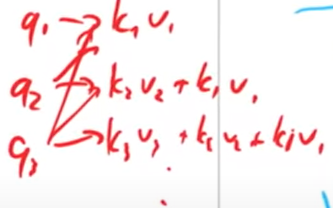
Causal Attention via prefix sums

Slide 25
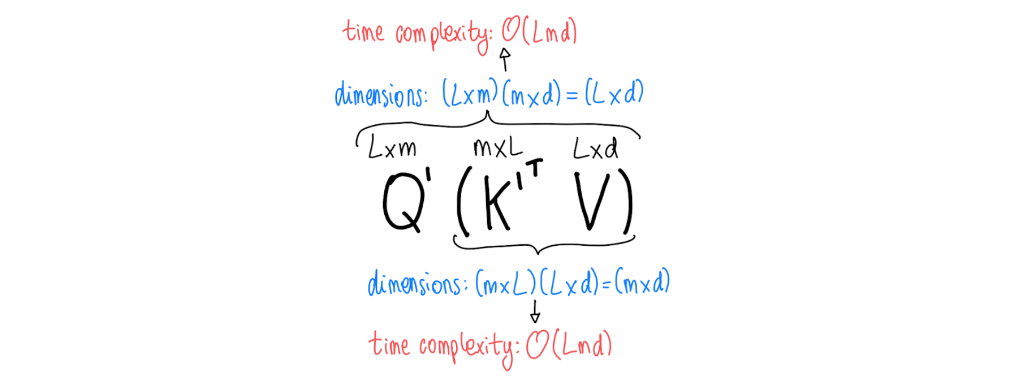
Finally :)

Slide 26
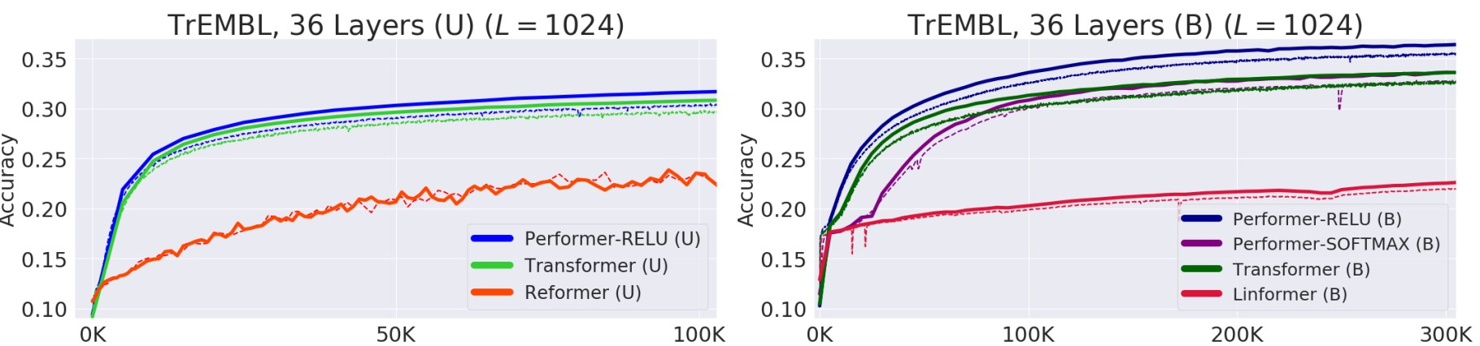
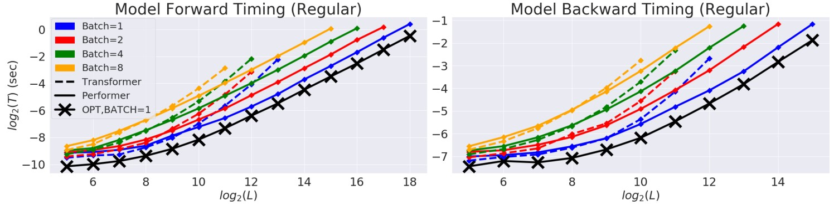
Comparisons

Slide 27
BROADER IMPACT
Biology and Medicine
Environment
Research on Transformers
Backward Compatibility
Attention Beyond Transformers

Slide 28
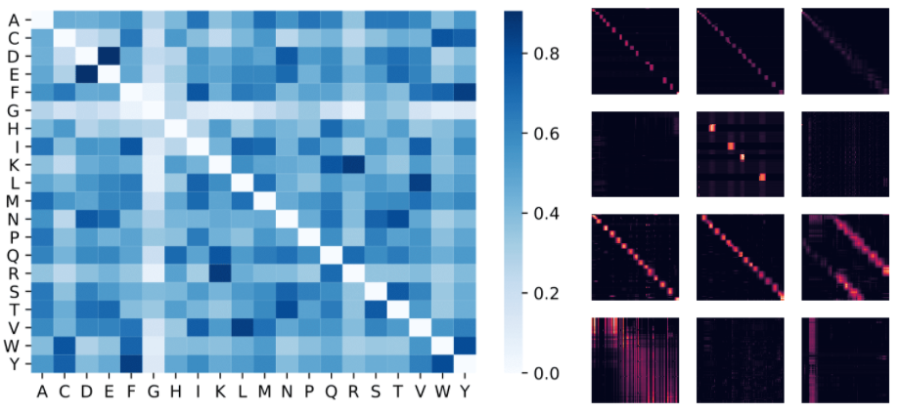
Applications

Slide 29
Resources
Linformer: Self-Attention with Linear Complexity (paper review)
Singular_value_decomposition
Linformer paper review YT video
Linformer: Self-Attention with Linear Complexity - arxiv
From Transformers to Performers: Approximating Attention
Rethinking Attention with Performers
Rethinking Attention with Performers - arxiv
Rethinking Attention with Performers (Paper Explained)

Slide 30
Thanks
hasanmahani08@gmail.com
rezadar1378@gmail.com

